Slide 1
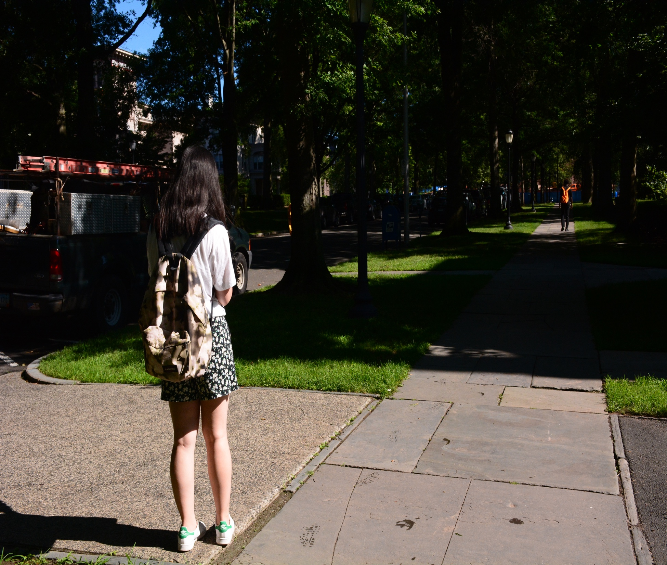
Wanqi Yue
Maggie
Self Introduction
“Try
2018-9-14
Everything”

Slide 2

Introduction
Content
01
About Me
02
About Study
03
About Future

Slide 3
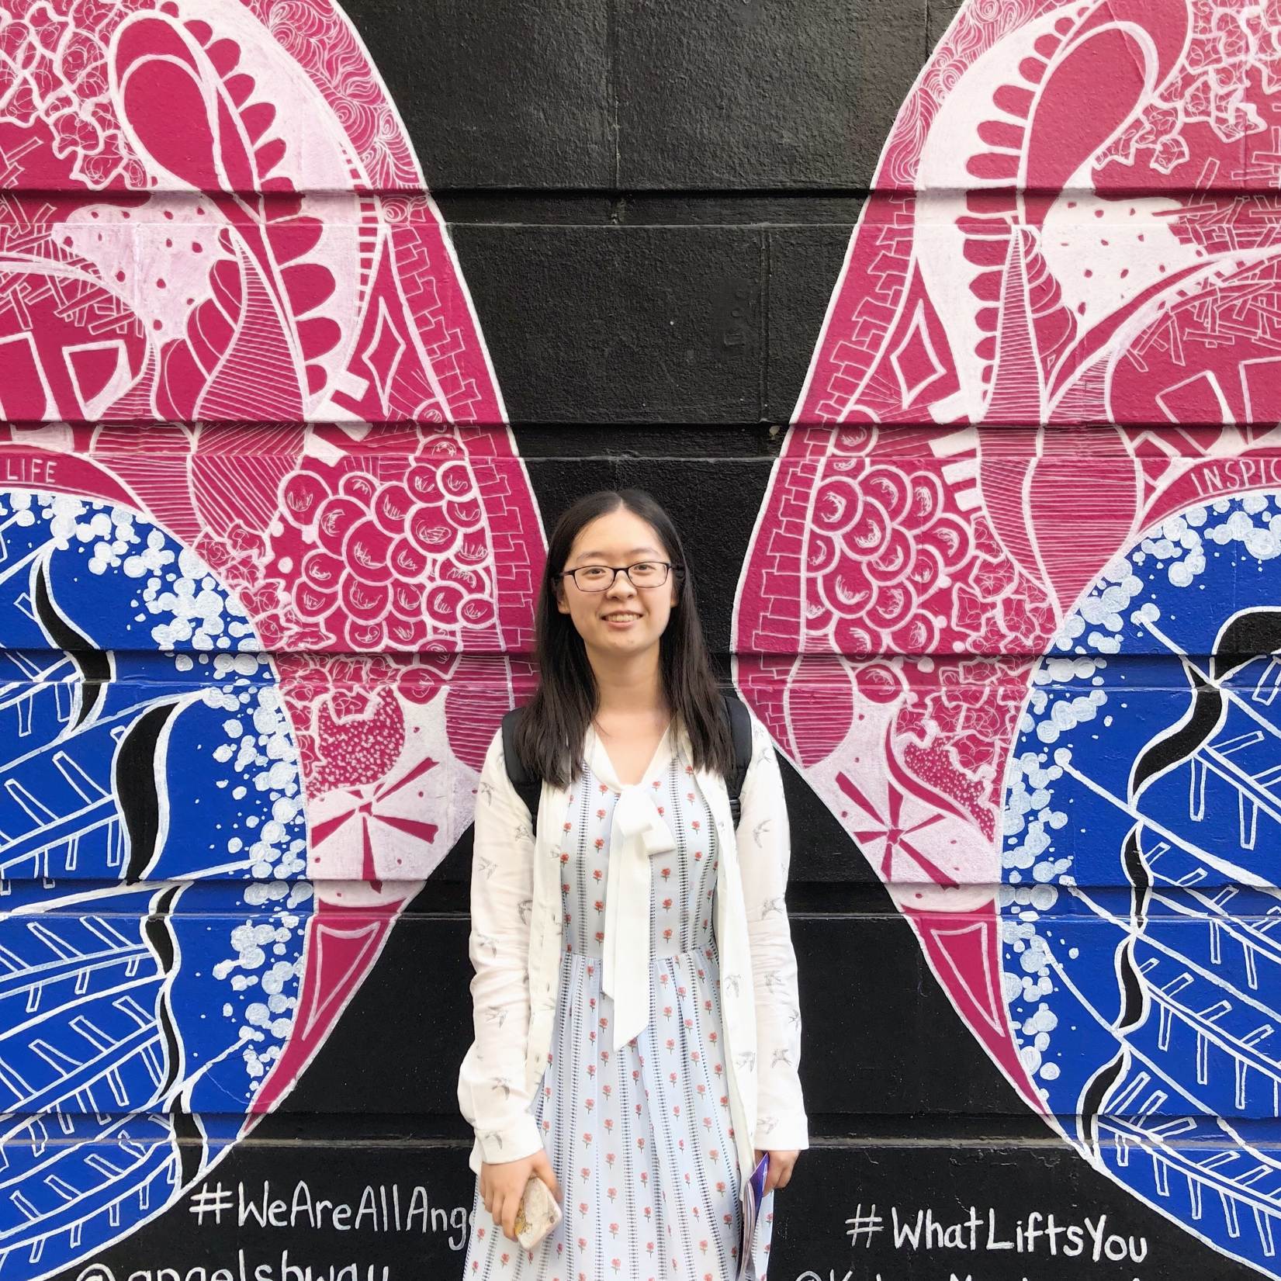
01 About Me
Wanqi Yue ---- Maggie
Qingdao, Shandong
Film and Theater
Angels in America by Tony Kushner
20th Century Women by Mike Mills
Debating
School and Faculty Debate team
Second prize

Slide 4
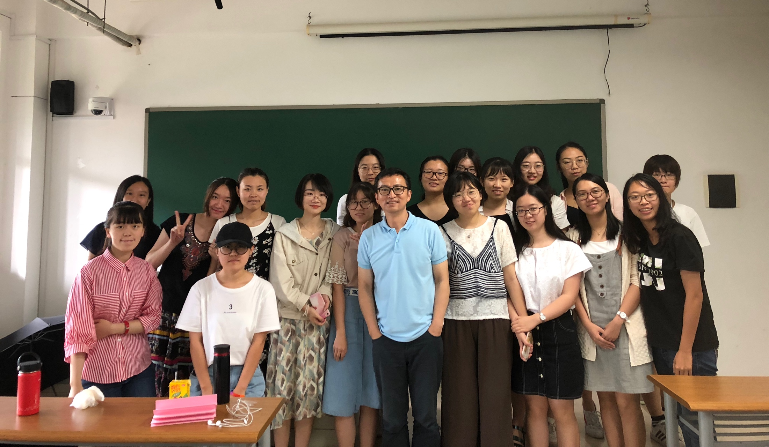
02 About Study
Pilot?
“Laboratory mice”!

Slide 5
University Courses
01
02
Compulsory
Optional
Keyword
Keyword
Combination of 3 majors
Sociology and Theater studies
i.e. News interviewing
Video production…
i.e. Caoyu’s plays within Modern China

Slide 6
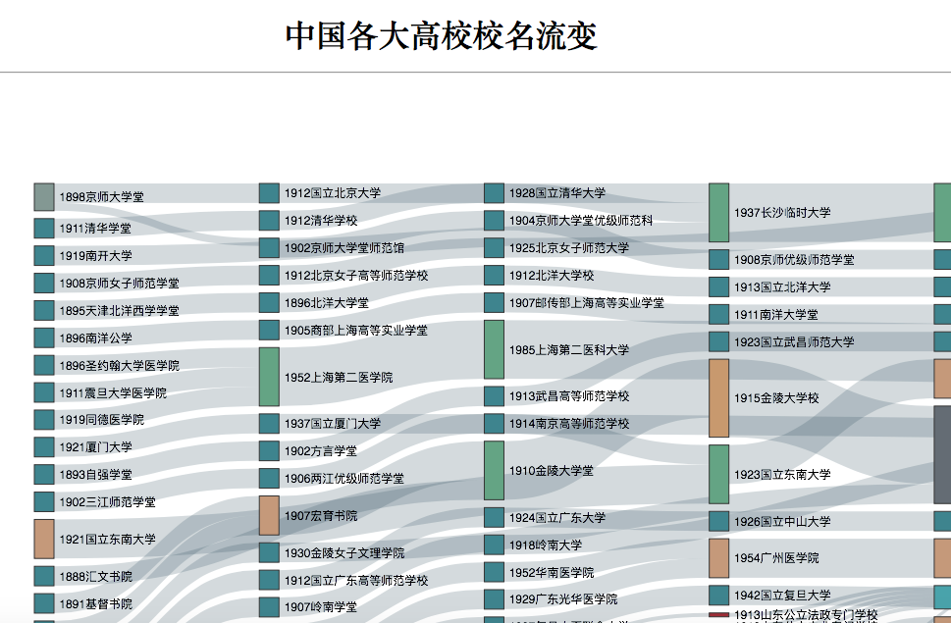
Major Projects
The Night Before the Champion
Feature story
The World Mandarin Debating Championship
2018-5-1
The Evolution of the Names of Chinese Universities
Data journalism and visualization

Slide 7

In Stirling…
Feel the diversity
Seeking for more possibilities…
Visit BBC
Join the uni newspaper
Explore and explore
3D printing
Hold a conference

Slide 8
03 About Future
Study abroad?
YSS
University of Stirling
Try something practical?
Internship in Jiangsu Broadcasting company and the JSChina.com
T.B.C.
iNTERNSHIP
STUDY
ABROAD
EXPERIENCE
LEARNING

Slide 9
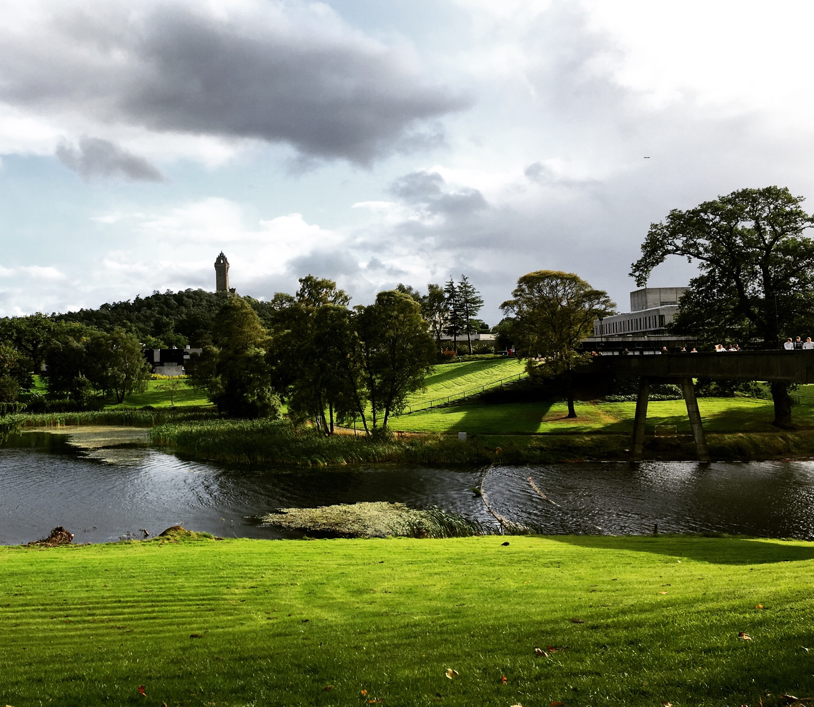
STAY CURIOUS
STAY ORIENTED
Wanqi Yue Maggie

